Slide 1


Building Conway’s ‘Game Of Life’ in React and Vue
@Paul_Hadfield

Slide 2
Tonight’s Presentation
About me:
Senior Innovation Developer at AutomationSquared
A digital prototype laboratory, based out of Horsham
Has had a love/hate relationship with Javascript since its inception
I’ll introduce:
Conway’s “Game Of Life”
Some basic concepts of React and Vue
A step by step approach to building a working website

Slide 3
What is Conway’s “Game Of Life”?
The Game of Life, also known simply as Life, is a cellular automaton devised by the British mathematician John Horton Conway in 1970
The game is a zero-player game, meaning that its evolution is determined by its initial state, requiring no further input
One interacts with the Game of Life by creating an initial configuration and observing how it evolves, or, for advanced players, by creating patterns with particular properties
Four basic rules govern all game play
Source: Wikipedia

Slide 4
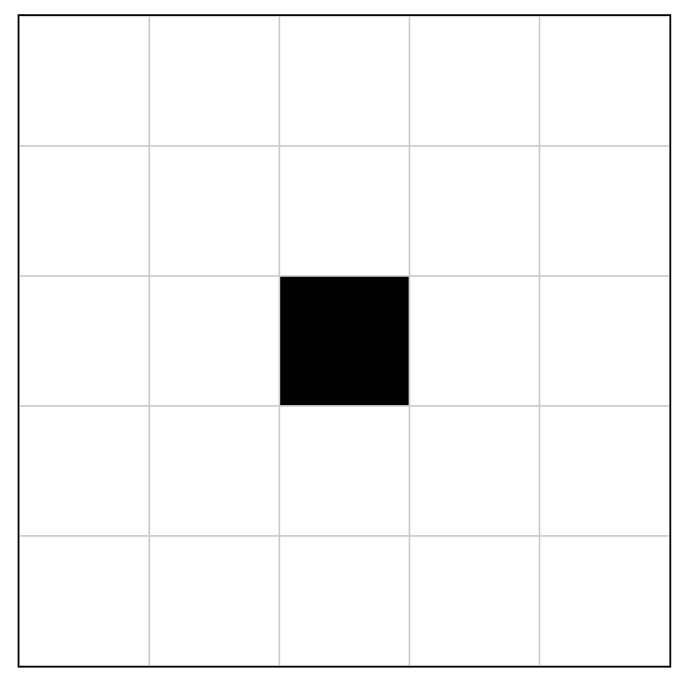
What are the rules?
Every cell interacts with its eight neighbours, which are the cells that are horizontally, vertically, or diagonally adjacent.
1
2
3
8
4
7
6
5
Source: Wikipedia

Slide 5
What are the rules?
Every cell interacts with its eight neighbours, which are the cells that are horizontally, vertically, or diagonally adjacent. At each step in time, the following transitions occur:
Source: Wikipedia

Slide 6
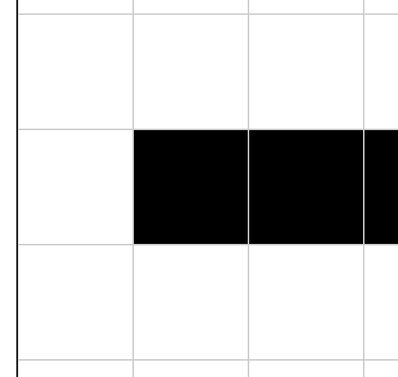
What are the rules?
Every cell interacts with its eight neighbours, which are the cells that are horizontally, vertically, or diagonally adjacent. At each step in time, the following transitions occur:
Any live cell with fewer than two live neighbours dies, as if by underpopulation
X
1
Source: Wikipedia

Slide 7
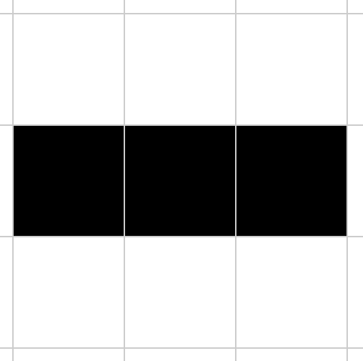
What are the rules?
Every cell interacts with its eight neighbours, which are the cells that are horizontally, vertically, or diagonally adjacent. At each step in time, the following transitions occur:
Any live cell with fewer than two live neighbours dies, as if by underpopulation
Any live cell with two or three live neighbours lives on to the next generation
1
X
2
Source: Wikipedia

Slide 8
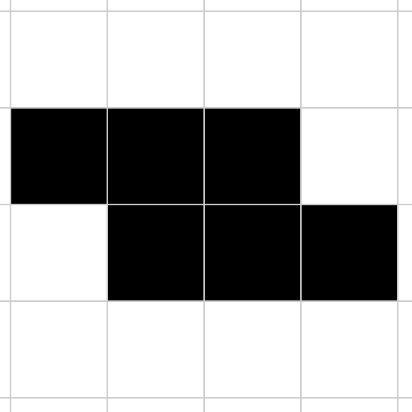
What are the rules?
Every cell interacts with its eight neighbours, which are the cells that are horizontally, vertically, or diagonally adjacent. At each step in time, the following transitions occur:
Any live cell with fewer than two live neighbours dies, as if by underpopulation
Any live cell with two or three live neighbours lives on to the next generation
Any live cell with more than three live neighbours dies, as if by overpopulation
1
2
3
X
4
Source: Wikipedia

Slide 9
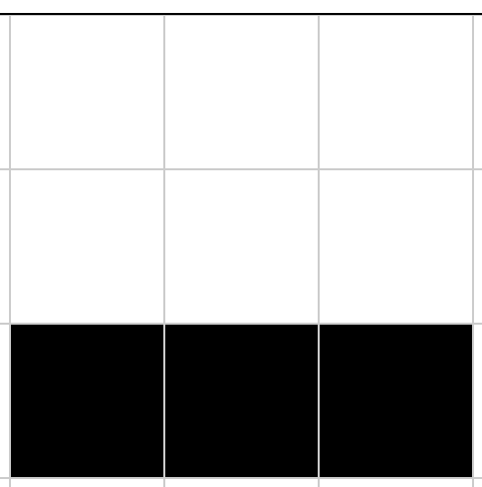
What are the rules?
Every cell interacts with its eight neighbours, which are the cells that are horizontally, vertically, or diagonally adjacent. At each step in time, the following transitions occur:
Any live cell with fewer than two live neighbours dies, as if by underpopulation
Any live cell with two or three live neighbours lives on to the next generation
Any live cell with more than three live neighbours dies, as if by overpopulation
Any dead cell with exactly three live neighbours becomes a live cell, as if by reproduction
X
1
2
3
Source: Wikipedia

Slide 10
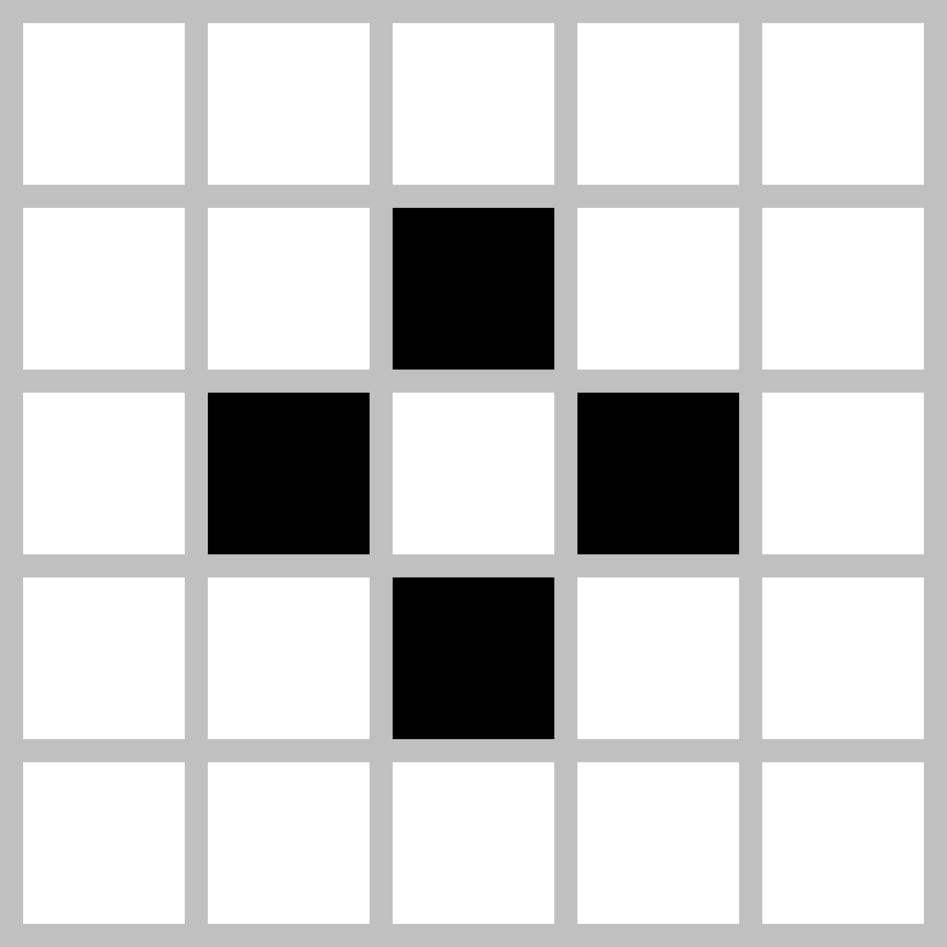
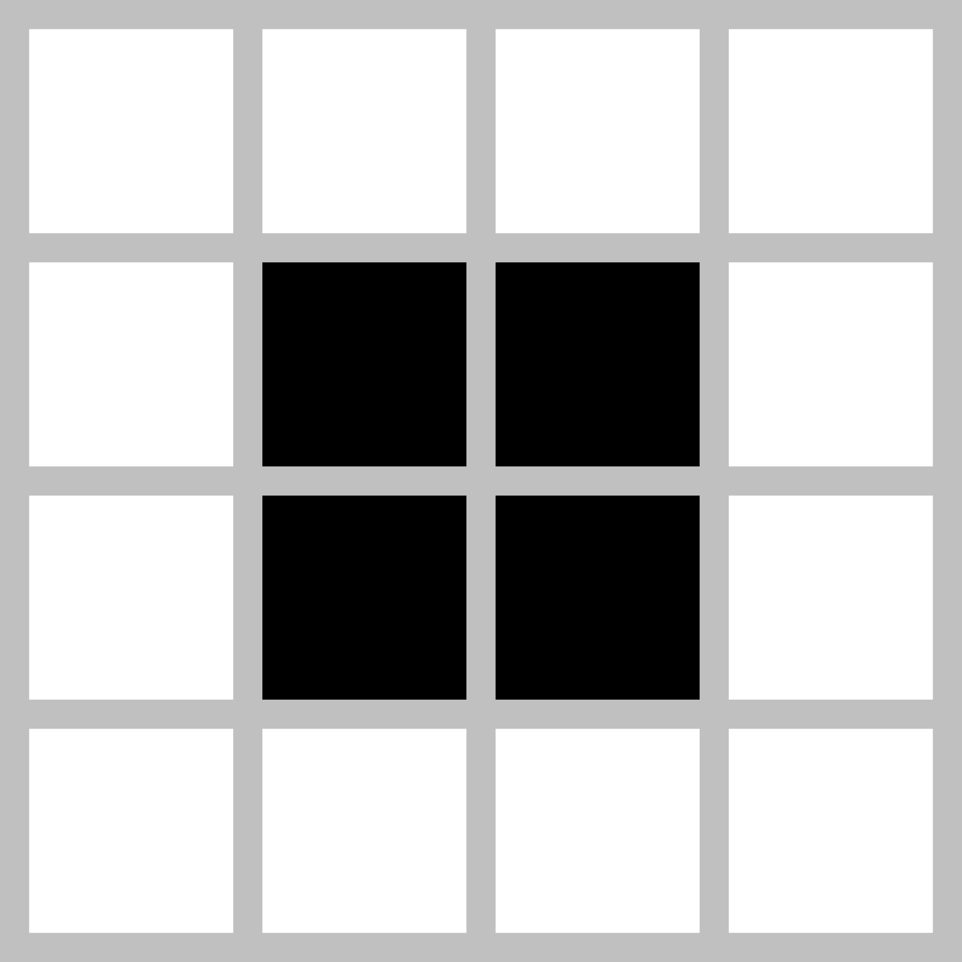
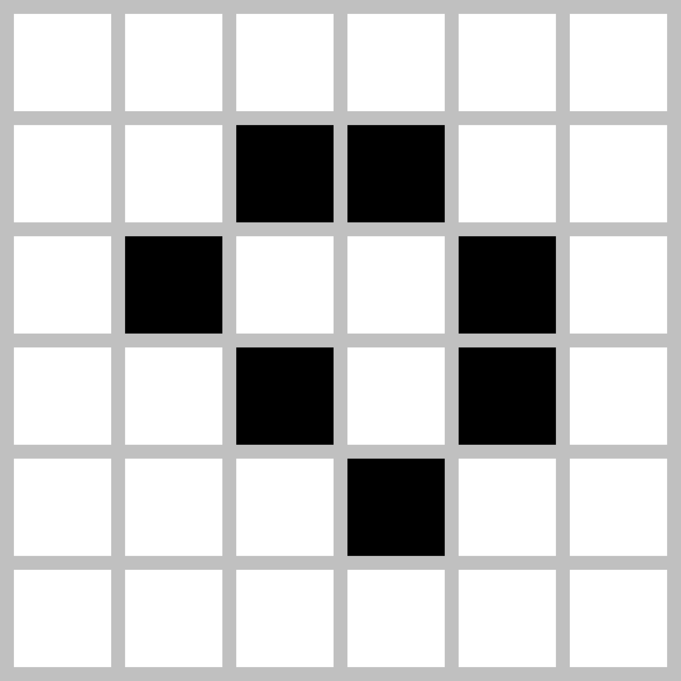
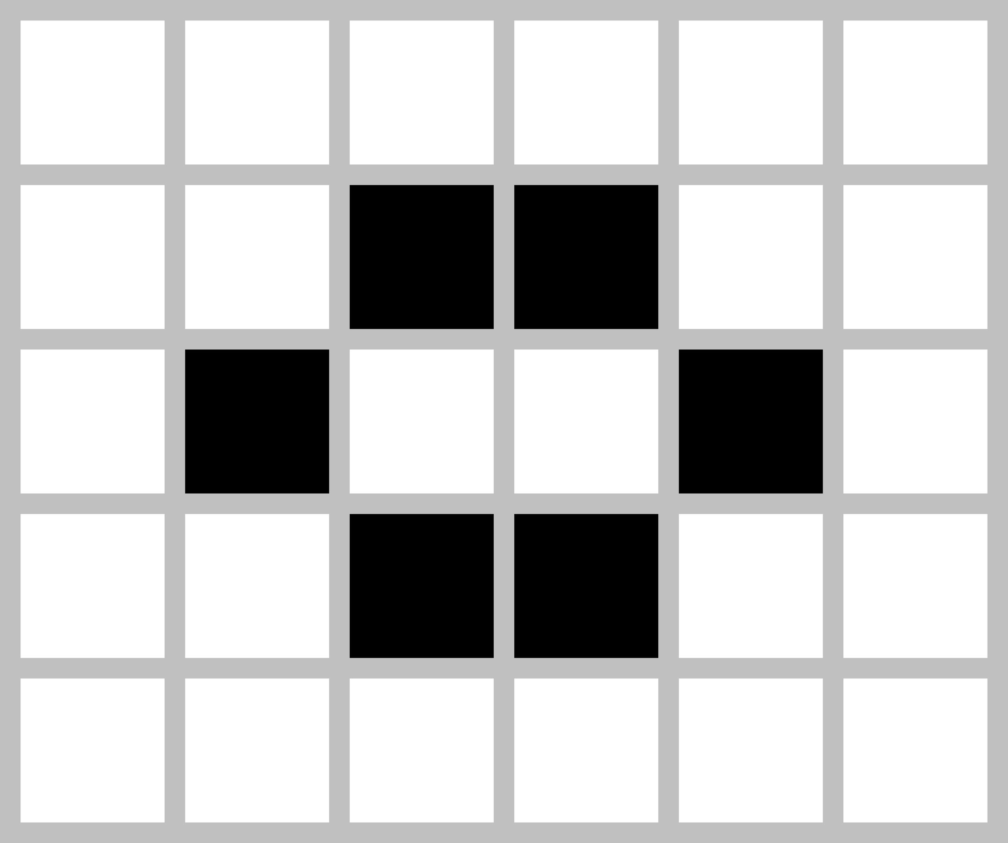
Examples of Patterns
Still Lifes
Oscillators
Tub
Block
Blinker
(period 2)
Toad
(period 2)
Loaf
Beehive
Beacon
(period 2)
Pulsar
(period 3)
Source: Wikipedia

Slide 11
Developing the Game Engine
Any live cell with fewer than two live neighbours dies, as if by underpopulation
Any live cell with two or three live neighbours lives on to the next generation
Any live cell with more than three live neighbours dies, as if by overpopulation
Any dead cell with exactly three live neighbours becomes a live cell, as if by reproduction
Source: Wikipedia

Slide 12
Developing the Game Engine
Any live cell with fewer than two live neighbours dies, as if by underpopulation
Any live cell with two or three live neighbours lives on to the next generation
Any live cell with more than three live neighbours dies, as if by overpopulation
Any dead cell with exactly three live neighbours becomes a live cell, as if by reproduction
Initial State

Slide 13
Developing the Game Engine
Any live cell with fewer than two live neighbours dies, as if by underpopulation
Any live cell with two or three live neighbours lives on to the next generation
Any live cell with more than three live neighbours dies, as if by overpopulation
Any dead cell with exactly three live neighbours becomes a live cell, as if by reproduction
Initial State
Number Of Live Neighbours

Slide 14
Developing the Game Engine
Any live cell with fewer than two live neighbours dies, as if by underpopulation
Any live cell with two or three live neighbours lives on to the next generation
Any live cell with more than three live neighbours dies, as if by overpopulation
Any dead cell with exactly three live neighbours becomes a live cell, as if by reproduction
Initial State
Number Of Live Neighbours
New State

Slide 15
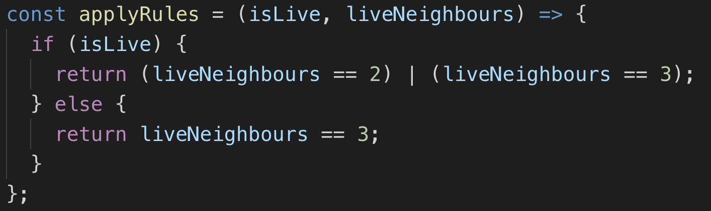
Developing the Game Engine
Any live cell with fewer than two live neighbours dies, as if by underpopulation
Any live cell with two or three live neighbours lives on to the next generation
Any live cell with more than three live neighbours dies, as if by overpopulation
Any dead cell with exactly three live neighbours becomes a live cell, as if by reproduction
newState = applyRules(currentState, liveNeighbours)

Slide 16
JavaScript Concepts
Arrow Functions
An arrow function expression is a syntactically compact alternative to a regular function expression, although without its own bindings to the this, arguments, super, or new.target keywords. Arrow function expressions are ill suited as methods, and they cannot be used as constructors.
Source: Mozilla

Slide 17
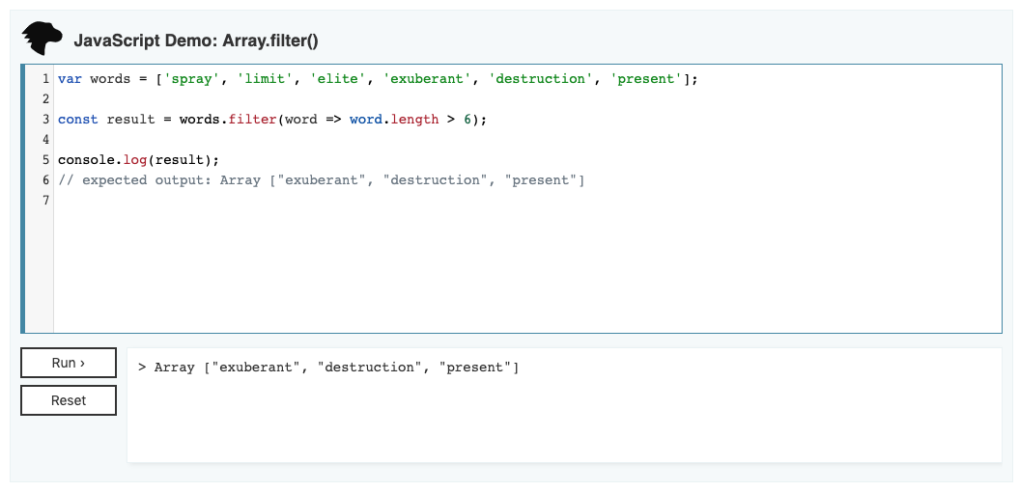
JavaScript Concepts
Array.Filter()
The filter() method creates a new array with all elements that pass the test implemented by the provided function.
Test are often written as arrow functions
Source: Mozilla

Slide 18
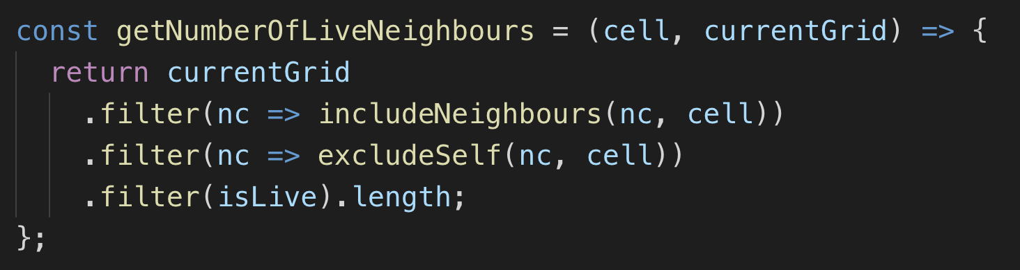
Determining Live Neighbours

Slide 19
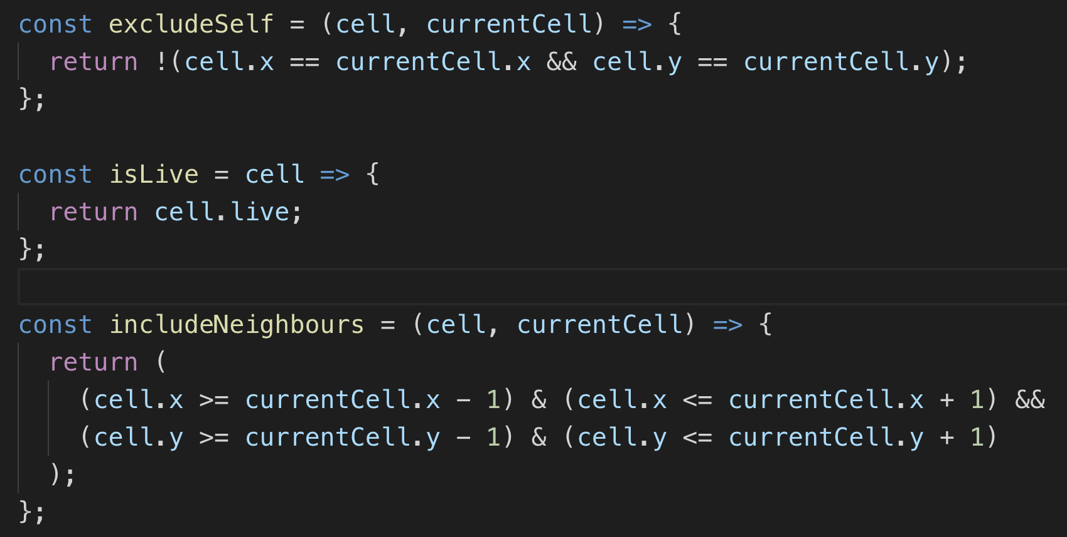
Determining Live Neighbours

Slide 20
Templates for Starting Projects
Options:
Use the CLI (and wait whilst it downloads half the internet as packages)
“vue create gof-vue” and select desired inputs
https://cli.vuejs.org/guide/creating-a-project.html#vue-create
“npm init react-app gof-react”
https://github.com/facebook/create-react-app
Use a prebuilt project template and change settings
For more control/include particular libraries/enforce company standards

Slide 21
Architecture: Common Approach
Four Components:
App
Top level component, responsible for calling Grid and Options Components
Interacts with “Game Of Life” engine and passes data to child component
Grid
Draws the grid and loops through each cell, passing to the Cell component
Cell
Draws the cell
Options
Handles displaying FORM for user interaction (introduced in final demo)

Slide 22
Architecture: Common Approach
Use minimal feature set to implement
Use ES6 features (arrow functions)
Keep things as simple as possible
Try not to use Redux and/or Vuex

Slide 23
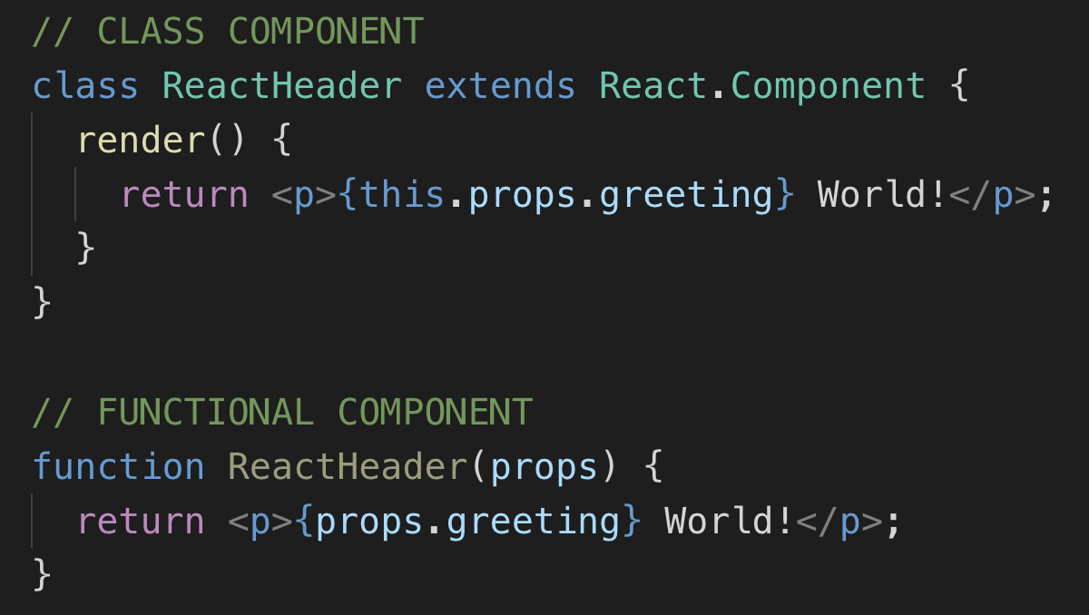
React Approach
Functional Components
New way to create React components
‘React Hooks’ give comparable feature set to class life cycle
ES6 feature, requires Babel to compile

Slide 24
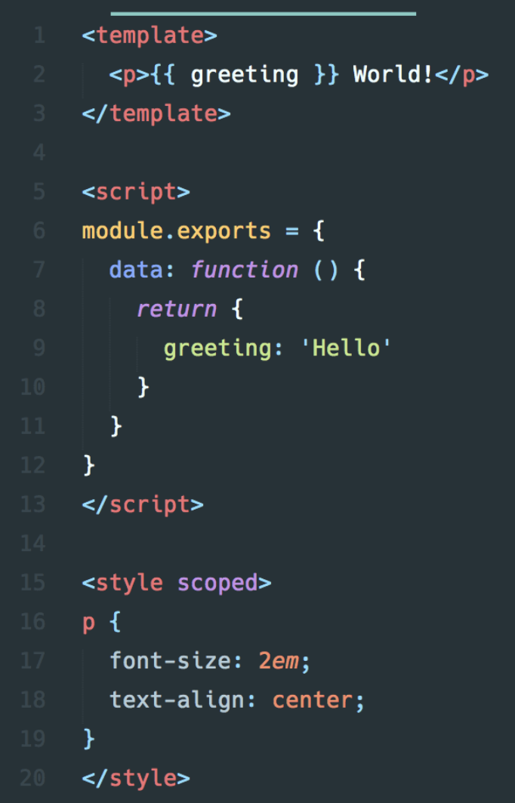
Vue Approach
Single File Components
Template
Component
Style

Slide 25
Implementation Steps
Display the “Game Engine” initial state
Display the initial state in a dynamically sized grid
Apply the “Game Engine” rules, displaying the evolving game state
Add the UI to change the initial state, and restart

Slide 26
Displaying Initial State
Create the default projects
Deleting the default components / assets
Create the required components
Grid and Cell
Add a copy of the “Game Engine” into project
Integrate the “Game Engine” into the App component
Passing data to the Grid component

Slide 27
Demo 1 – Display Initial State
Demo Time

Slide 28

Implementation Steps
Display the “Game Engine” initial state
Display the initial state in a grid
Apply the “Game Engine” rules, displaying the evolving game state
Add the UI to change the initial state, and restart

Slide 29

Implementation Steps
Display the “Game Engine” initial state
Display the initial state in a grid
Apply the “Game Engine” rules, displaying the evolving game state
Add the UI to change the initial state, and restart

Slide 30
Styling Components
Apply ‘CSS Grid’ to existing Grid/Cell HTML Div’s
Great Resource: https://gridbyexample.com/examples/
Dynamically calculate grid dimensions
“Game Of Life” examples have different number of rows / columns
vs
5x5
17x17

Slide 31
Demo 2 – CSS Grid
Demo Time

Slide 32

Implementation Steps
Display the “Game Engine” initial state
Display the initial state in a grid
Apply the “Game Engine” rules, displaying the evolving game state
Add the UI to change the initial state, and restart

Slide 33
Implementation Steps
Display the “Game Engine” initial state
Display the initial state in a grid
Apply the “Game Engine” rules, displaying the evolving game state
Add the UI to change the initial state, and restart

Slide 34
State Change 101
Create an instance of a component
Populate the required data and add to local state
Bind the state tracked data to the template
Render the template
Respond to an event, updating the data held in state
React/Vue re-renders the template, with the updated data
Using a shadow DOM and tracked ‘keys’ to reduce changes

Slide 35
React: Updating State
React Hooks
Introduced in React 16.8
Uses the naming convention “use….”
Functional Components are now as powerful as Class Components
Source: React Documentation

Slide 36
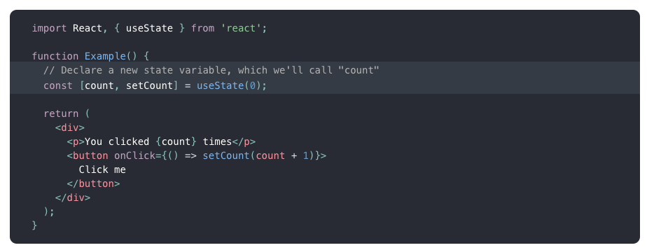
React: Updating State
“useState” React Hook
Provide an initial state
Returns instance of value and function to set new value (state)
Source: React Documentation

Slide 37
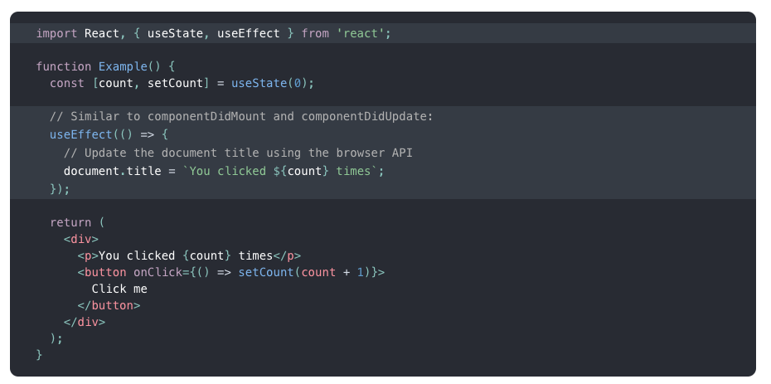
React: Updating State
“useEffect” React Hook
Use for ‘Side Effects’ (i.e. HTTP Calls, scheduling calls)
Similar to class component life cycle events “componentDidMount”, “componentDidUpdate” and “componentWillUnmount” combined
Source: React Documentation

Slide 38
Demo 3 – React: Updating State
Demo Time

Slide 39
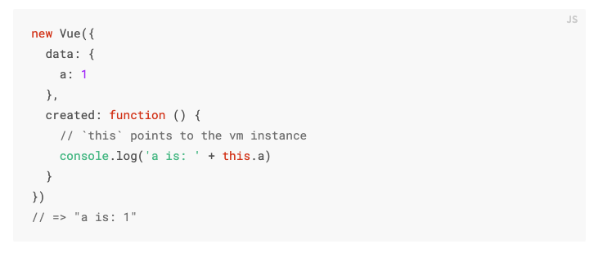
Vue: Updating State
Uses life cycle events
Created
beforeDestroy
Source: Vue Documentation

Slide 40
Demo 4 – Vue: Updating State
Demo Time

Slide 41
Implementation Steps
Display the “Game Engine” initial state
Display the initial state in a grid
Apply the “Game Engine” rules, displaying the evolving game state
Add the UI to change the initial state, and restart

Slide 42
Implementation Steps
Display the “Game Engine” initial state
Display the initial state in a grid
Apply the “Game Engine” rules, displaying the evolving game state
Add the UI to change the initial state, and restart

Slide 43
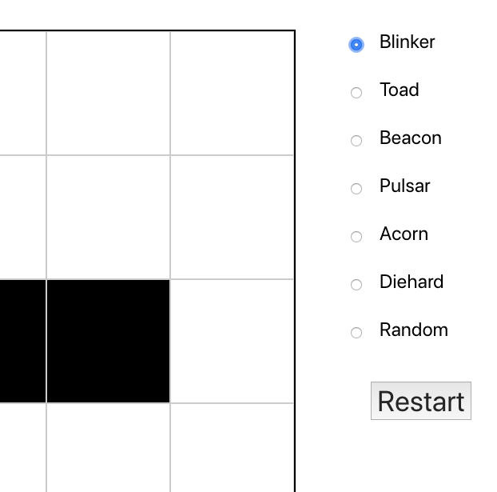
FORM data / User Interaction
Add new component:
Options
Inter-component Communication
Parent to sibling or Sibling to parent
Local state
Sibling to sibling
Redux to Vuex
Design skills optional

Slide 44
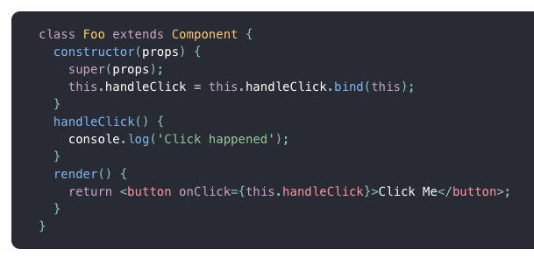
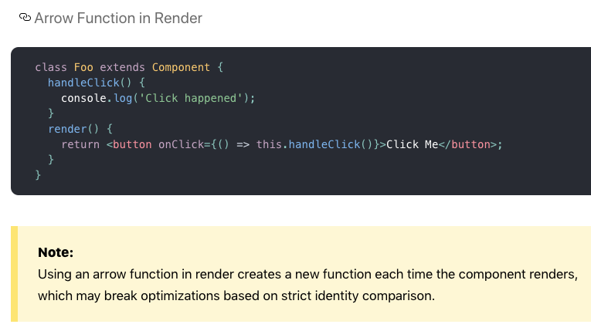
FORM data / User Interaction
React
Functions passed in from parent as props
Source: React Documentation

Slide 45
Demo 5 – React: Select “Initial State” UI
Demo Time

Slide 46
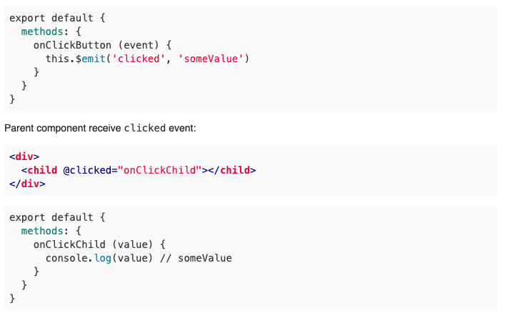
FORM data / User Interaction
Vue:
Initial state passed in as props
Events emitted to parent
Source: Vue Forums

Slide 47
Demo 6 – Vue: Select “Initial State” UI
Demo Time

Slide 48
Implementation Steps
Display the “Game Engine” initial state
Display the initial state in a grid
Apply the “Game Engine” rules, displaying the evolving game state
Add the UI to change the initial state, and restart

Slide 49
Conclusion
Vue and React are very similar
Both were easy to pick up
React Event hooks work really well
Feels easier passing functions into react
Compared to Vue emitting events
I think I actually prefer React (a surprise)
I still have a love/hate relationship with Javascript

Slide 50
Thank you – Any questions?
GitHub: Slides and source code can be found here
https://github.com/Paul-Hadfield/GameOfLife-Talk
Contact me on Twitter: @Paul_Hadfield

